Slide 1
Learning Activity 3.1.2
Image 1
UN Core Pre-Deployment Training Materials 2017

Slide 2
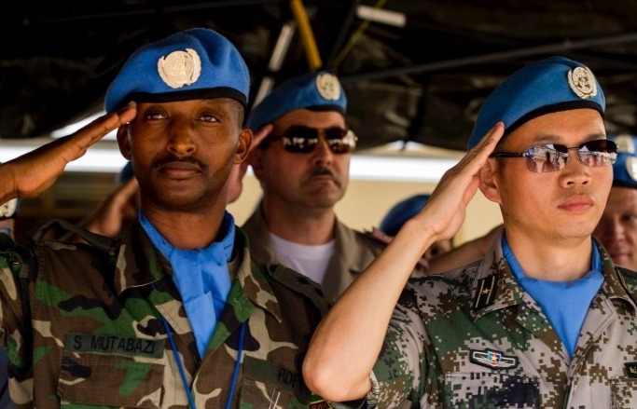
Learning Activity 3.1.2
Image 2
UN Core Pre-Deployment Training Materials 2017

Slide 3
Learning Activity 3.1.2
Image 3
UN Core Pre-Deployment Training Materials 2017

Slide 4
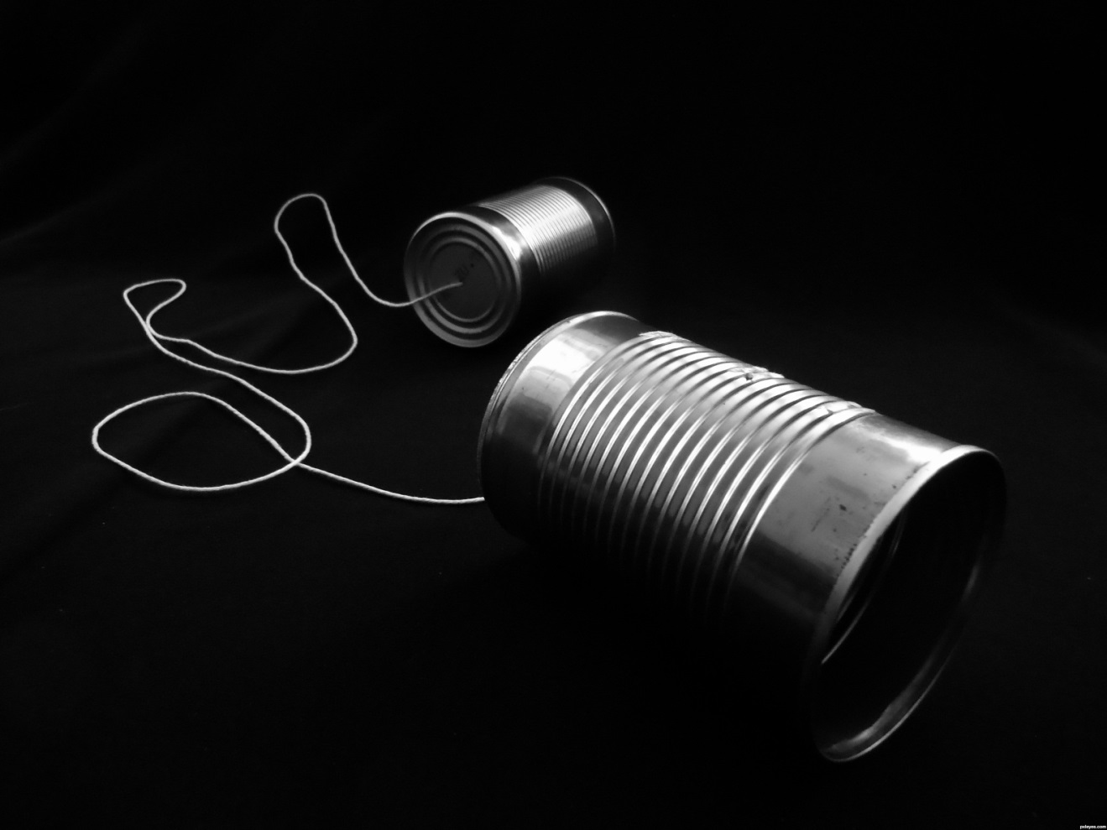
Learning Activity 3.1.2
Image 4
UN Core Pre-Deployment Training Materials 2017

Slide 5
Learning Activity 3.1.2
Image 5
UN Core Pre-Deployment Training Materials 2017

Slide 6
Learning Activity 3.1.2
Image 6
UN Core Pre-Deployment Training Materials 2017

Slide 7
Learning Activity 3.1.2
Image 7
UN Core Pre-Deployment Training Materials 2017

Slide 8
Learning Activity 3.1.2
Image 8
UN Core Pre-Deployment Training Materials 2017

Slide 9
Learning Activity 3.1.2
Image 9
UN Core Pre-Deployment Training Materials 2017

Slide 10
Learning Activity 3.1.2
Image 10
UN Core Pre-Deployment Training Materials 2017

Slide 11
Learning Activity 3.1.2
Image 11
UN Core Pre-Deployment Training Materials 2017

